Slide 1

Adding Custom Entities to Azure Cognitive Search
August 6, 2020

Slide 2
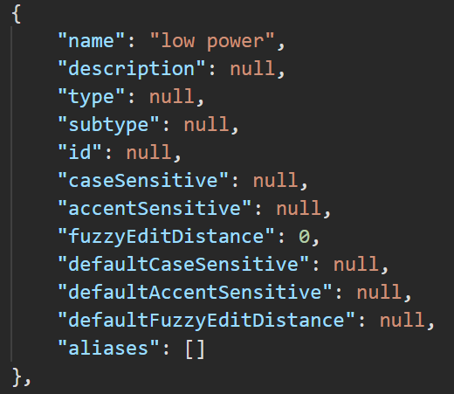
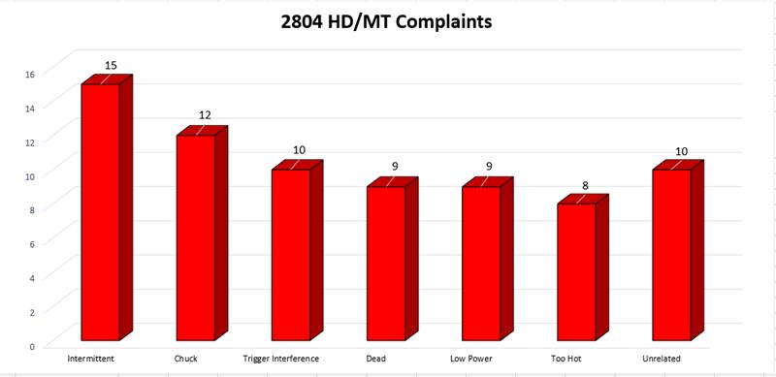
Search Terms added to Skillset
Default case sensitivity is false
Expand search by adding aliases
FuzzyEditDistance accounts for how many characters can be different for the word to still be a match
FuzzyEditDistance has a max of 5

Slide 3
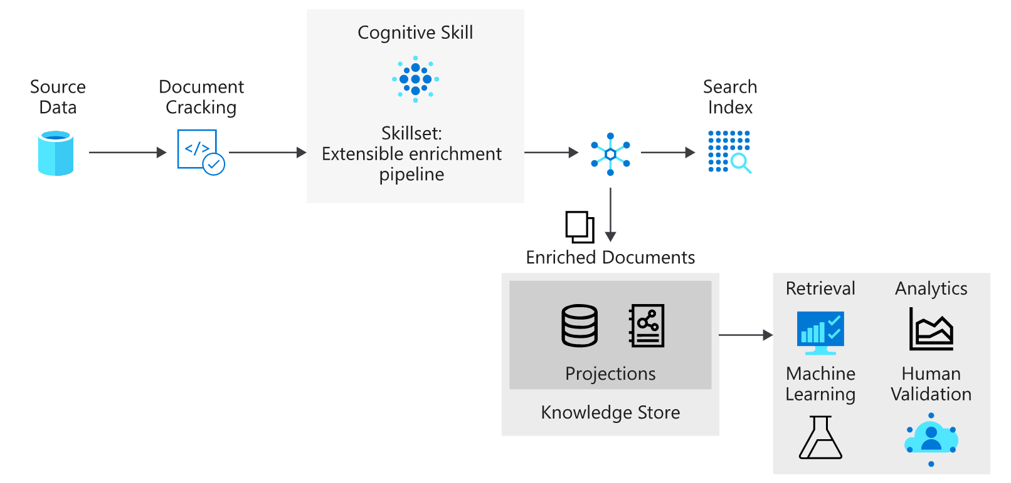
How Azure Cognitive Search Works
Current Skills:
Sentiment Analysis
Key Phrase Extraction
Translate Text
Language Identification
*Skill to Add:
Custom Entity Lookup

Slide 4
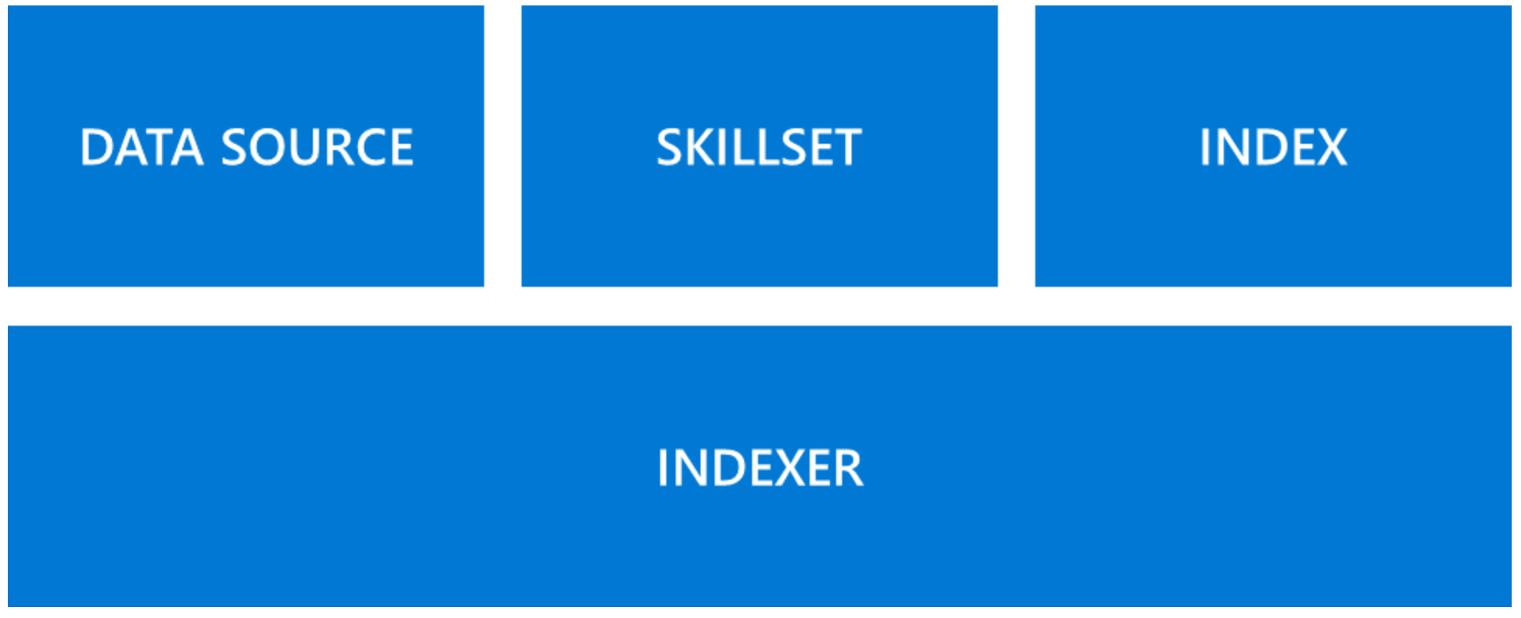
Process for Adding the New Skill
Add a field to the index (Postman*)
Provides a landing spot for our detected terms
Update the Skillset (Postman*)
Add the custom entity skill to the skillset
Update the shaper skill (allows us to manage complex types)
Add a table to the Knowledge store to access data in Power BI
Update the Indexer (Postman*)
Update outfield mappings to connect skill to index
Re-run the Indexer (Portal)
Reset and rerun the indexer to add the new skills to the documentation
Connect to tables in Power BI (Power BI)
*For each Postman request, we will first issue a GET request to access the existing skillset, index or indexer. Then we will issue PUT requests to update them

Slide 5
Azure Cognitive Search Resources
Tutorial for adding your custom entities: https://github.com/balakreshnan/MilwaukeeTools/blob/master/TextAnalytics/customentity.md
Other Resources:
Create a knowledge store using REST and Postman: https://docs.microsoft.com/en-us/azure/search/knowledge-store-create-rest
Connect a knowledge store with Power BI: https://docs.microsoft.com/en-us/azure/search/knowledge-store-connect-power-bi
About the Custom Entity Skill: https://docs.microsoft.com/en-us/azure/search/cognitive-search-skill-custom-entity-lookup

Slide 6
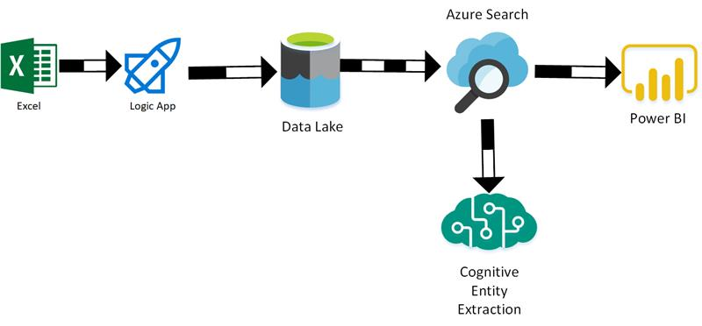
Potential Architecture

